Slide 1
Strategic Planning
Module 1
Introduction to Strategy, Planning and Structure
Instructor: Moataz Darwish, MBA

Slide 2
Contents
Strategic Planning: The Context
What Is Strategic Planning?
The Process of Strategy and Decision Making
Business and Corporate Strategy
The Development of Strategic Ideas
Is Strategic Planning Only for Top Management?

Slide 3
Strategic Planning: The Context
Strategic planning is usually the capstone course in MBA courses.
Core courses:
  Organizational behavior
  Economics
  Marketing
  Finance
  Accounting
  Project management
  Strategic planning
  One thing is certain: strategic planning is not independent
  of the other core disciplines.

Slide 4
Contents
Strategic Planning: The Context
What Is Strategic Planning?
  Managers’ Definitions of Strategy
  Academic Definitions of Strategy
  Three Approaches to Strategic Planning
    The Planning Approach
    Emergent Strategy
    Resource Based Strategy
  Rittell’s Tame And Wicked Problems
  The Origins of Strategy and Tactics
  Strategy and the Scientific Approach
  Strategic Planning and Strategic Thinking
The Process of Strategy and Decision Making
Business and Corporate Strategy
Is Strategic Planning Only for Top Management?

Slide 5
What Is Strategic Planning?
Strategic planning is a complex activity.
Compare its degree of complexity with another complex activity economic policy making.

Slide 6
What Is Strategic Planning?
Managers’ Definitions of Strategy
Knowing where you are going and how you are going to get there.
Setting a clear set of objectives and mobilising resources to achieve them.
Thinking in the long rather than the short term.
Working out how to do better in the market place than your competitors.
Deriving and selecting a course of action.

Slide 7
What Is Strategic Planning?
Academic Definitions of Strategy
The pattern of objectives, purposes or goals, and the major policies and plans for achieving these goals, stated in such a way as to define what business the company is in or should be in and the kind of company it is or should be - portrays strategy as a pattern of objectives which define what the company is and intends to be in a broad sense.
The decisions taken over time by top managers, which, when understood as a whole, reveal the goals they are seeking and the means used to reach these goals. Such a definition of strategy is different from common business use of the term in that it does not refer to an explicit plan. In fact, by my definition strategy may be implicit as well as explicit - suggest that strategy can only be understood after the event

Slide 8
What Is Strategic Planning?
Several ways of approaching the idea.
Three Approaches to Strategic Planning
  The Planning Approach (purely planning exercise)
  Emergent Strategy (a course of action which emerges over time)
  Resource Based Strategy (the outcome of the resources which are available to the company).

Slide 9
Extra material – Strategy Safari

Slide 10
What Is Strategic Planning?
Three Approaches to Strategic Planning
  The Planning Approach (purely planning exercise)
    set of objectives have been determined
    the business environment analyzed and forecasts made,
    a plan worked out by senior management
    passed down for implementation;
    this plan is then adhered to over the planning time scale.
    BUT

Slide 11
What Is Strategic Planning?
Three Approaches to Strategic Planning
  The Planning Approach ASSUMES:
    The future can be predicted accurately enough to make rational choices.
    It is possible to detach strategy formulation from everyday management.
    It is possible to forego short-term benefit in order to gain long-term advantage.
    The strategies proposed are capable of being managed in the way proposed.
    The CEO has the knowledge and power to choose among options. He does not need to persuade anyone, nor compromise his decisions.
    After careful analysis, strategy decisions can be clearly specified, summarized and presented; they do not need to be altered because circumstances outside the company have changed.
    Implementation is a separate and distinctive phase that only comes after a strategy has been agreed.

Slide 12
What Is Strategic Planning?
Three Approaches to Strategic Planning
  The Planning Approach
the attempt to drive corporate strategy in this
restrictive fashion is unproductive.

Slide 13
What Is Strategic Planning?
Three Approaches to Strategic Planning
  Emergent Strategy:
    strategy is not planned before the event.
    Strategy emerges over time in an unpredictable manner.
      hence may appear to have little structure.
    the world is actually too complex.
    ‘bounded rationality’ (it is impossible to take into account the complexity of real life).
    ‘Satisfying’
      Decision makers collect information and defer selecting a course of action until the costs of further delay and information collection are considered to be greater than the potential benefits of searching out a better option.
      the decision maker satisfies himself that there is nothing more to be gained from further delay.
    In fact, it turns out that you can not actually get hold of the really important information.
    BUT

Slide 14
What Is Strategic Planning?
Three Approaches to Strategic Planning
  Emergent Strategy:
    the company can still be directed along the general lines of a broad mission.
    There is a need for efficient resource allocation;
    Compromises are more of a constraint than a barrier to action.
    degree of long term planning is inevitable for long term investments.
    Satisfying is in itself a rational basis for choice,

Slide 15
What Is Strategic Planning?
Three Approaches to Strategic Planning
  Emergent Strategy:
There is some middle ground between trying to plan for all eventualities and simply reacting to events as they occur.

Slide 16
What Is Strategic Planning?
Three Approaches to Strategic Planning
  Resource Based Strategy:
    Emphasis on the internal resources available to the company.
    Source of competitive advantage rests within the organization's resources.
    Focus on the way labor and capital resources are utilized.
    Resources develops the ability not only to take advantage of opportunities as they arise, but to create the opportunities themselves by innovative behavior.
    Research in this school is in the relatively early stages;

Slide 17
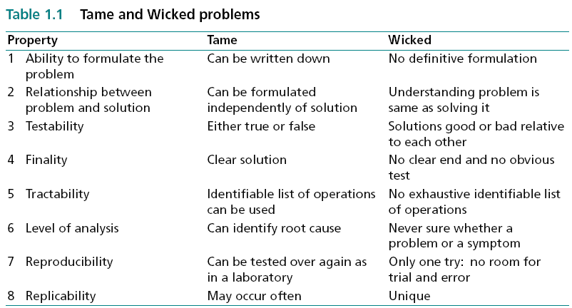
What Is Strategic Planning?
Rittell’s Tame And Wicked Problems
  Strategic planning emerges overwhelmingly as a wicked problem, which means:
    tend to be loosely defined.
    Not always clear what the problem is.
    Never quite clear whether a satisfactory solution has been arrived at.

Slide 18
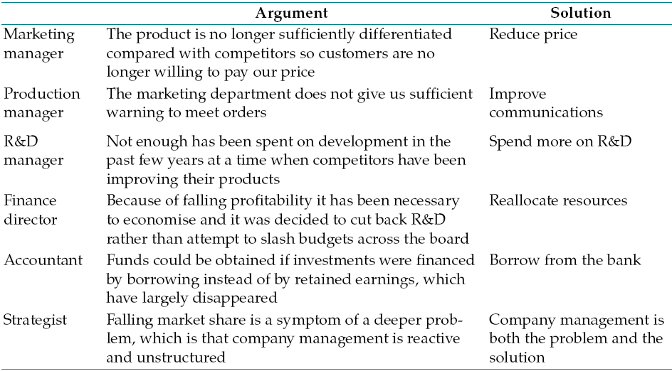
What Is Strategic Planning?
Rittell’s Tame And Wicked Problems
For example, consider the case of a company that is losing market share. What is the root cause? The type of argument and suggested solutions that might be submitted by different managers are as follows:
This discussion, variations of which occur repeatedly in real life, touches on all eight Rittel properties. There is no agreement on formulating the problem (1). Each formulation suggests its own solution: lower the price, increase R&D expenditure, borrow money, or whatever; but if the strategist is right, then understanding the problem is the solution (2). None of the suggested solutions provides a full answer (3). It is not possible to test which solution will solve the problem (4). There is no agreement on howt he problem can be solved (5). The strategist claims the problem is a symptom (6). There is only one opportunity for action before the company goes bankrupt (7). The set of circumstances facing the company is unique in its experience (8).

Slide 19
What Is Strategic Planning?
The Origins of Strategy and Tactics
  The roots of the word ‘strategy’ lie in the Greek strategio, meaning a general, stratos meaning ‘an army’, and agein meaning ‘to lead’.
  Tactics is a notion which is closely related to strategy. Again, the meaning can be clarified by the Greek roots: taktikos meaning fit for arranging, and taktos meaning ordered. The military definition relates to the science or art of manoeuvring in the presence of the enemy.
  In the military context,
    Strategy is deciding what is to be done,
    Tactics is deciding how individual objectives are to be achieved.
    the military analogy does not fit exactly with the business environment, the difference between strategy and tactics is not clear cut in the business context.

Slide 20
What Is Strategic Planning?
The Origins of Strategy and Tactics
  Given the imprecision of the terminology, and the activity itself, it is not surprising to find that various terms are used to describe the process, they include:
    Strategic management,
    Business strategy,
    Business policy,
    Corporate planning and
    Long range planning.

Slide 21
What Is Strategic Planning?
The Strategy and the Scientific Approach
The Scientific Approach
Theory based on ideas
Hypothesis derived from theory
(something which can be tested)
Data Collection & Analyses
Hypothesis accepted or rejected

Slide 22
What Is Strategic Planning?
The Strategy and the Scientific Approach
  Scientific approach outlined above is just a paradigm of thought, and is not even rigorously applied in physics, a discipline in which there is a great deal of speculative thinking.
  Apply the scientific method to strategy making is faced with several intractable problems:
    Different views on what strategic planning actually is;
    The types of companies, environments, problems are so different
    Significant interactions among variables;
    Impossible to disentangle cause and effect.
    The problem of dealing with large numbers of interacting variables subject to lags is not unique to the analysis of strategic planning;

Slide 23
What Is Strategic Planning?
The Strategy and the Scientific Approach
  To some extent there is a degree of fashion in strategy advice.
  So much credibility is attached to prescriptions which have no empirical foundation.
  In Search of Excellence book (J Peters, Waterman) – 43 US CO.

Slide 24
What Is Strategic Planning?
  Conclusion so far, Strategic planning is;
    A complex activity,
    Many definitions,
    At least three different approaches
    Strategy has the characteristics of a wicked problem,
    Scientific method cannot easily be applied to strategy.

Slide 25
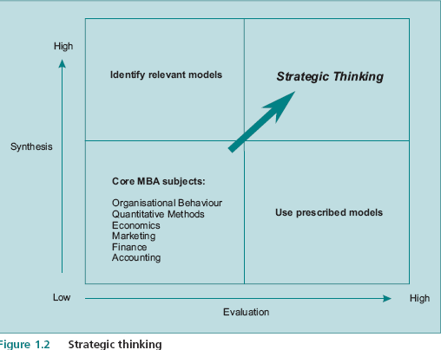
What Is Strategic Planning?
The Strategic Planning and Strategic Thinking
  - two skills which are fundamental
  to strategic thinking:
    synthesis and
    evaluation.
identify the relevant models to
apply to a particular issue.
weigh up the pros and cons of
potential courses of action and
arrive at a reasoned conclusion

Slide 26
What Is Strategic Planning?
The Strategic Planning and Strategic Thinking
  The strategist has to think more widely and deeply than the individual functional specialists.
  This is an extremely difficult game to play and it goes without saying that unless you practice you will never get into the top right hand box.

Slide 27
Contents
Strategic Planning: The Context
What Is Strategic Planning?
The Process of Strategy and Decision Making
  Strategy Dynamics
  The Mythical Company
Business and Corporate Strategy
Is Strategic Planning Only for Top Management?

Slide 28
The Process of Strategy and Decision Making
Strategy decision is an advance into the unknown,
There is no one correct course of action;
All that can be done is to:
  interpret the current situation,
  form expectations about the future,
  act according to personal views on risk and the likely course of events.
Helping to avoid disastrous courses of action.

Slide 29
The Process of Strategy and Decision Making
Strategy Dynamics
Strategy can only be properly understood in a dynamic rather than a static setting.
A great deal of what was thought to be random was in fact deterministic but chaotic,
  in the sense that it could be described mathematically but exhibited what appeared to be random behaviour.

Slide 30
Mythical Co Exercise

Slide 31
The Mythical Company
The 3 Big Strategic Questions
1-How Well Are We Performing?
‘where are we now?’
2-What Should We Be Doing in the Future?
‘Where do we want to go?’
3- How Can We Achieve Successful Change?
‘How will we get there?’
Elements of Strategic Planning
Structure – of thought
Analysis – of data using the structure
Integration – of the above to arrive at decision
Evaluation – system to monitor allocation of resources
Feedback – door left open to modify as events unfold

Slide 32
Contents
Strategic Planning: The Context
What Is Strategic Planning?
The Process of Strategy and Decision Making
Business and Corporate Strategy
  Allocating Corporate Resources
  Development of Corporate Strategies
Is Strategic Planning Only for Top Management?

Slide 33
Business and Corporate Strategy
A large proportion of economic activity takes place in firms of varying forms.
There is a clear distinction between corporate and business strategy:
  The firm can be visualized as a group of strategic business units (SBUs) which are coordinated and directed by a corporate headquarters.
  An SBU is an operating division of a company which serves a distinct product market segment or a well defined set of customers or a geographic area.

Slide 34
Business and Corporate Strategy
The corporate objectives and guidelines comprise the strategy for the company as a whole,
  determining the portfolio of SBUs;
  allocating resources among SBUs;
  developing new business ventures;
  appointing SBU CEOs (capital rationing).
the SBUs are tactical units charged with achieving their part of the overall strategy;
  what is the market?
  which segments are products aimed at?
  what is the competition?
  can a sustainable competitive advantage be achieved?

Slide 35
Business and Corporate Strategy
While the concerns of corporate and SBU strategy might differ, it is clear that there are many common themes, such as
  interpreting diverse information,
  allocating resources effectively, and
  reconciling the short and long term.
A recurrent theme is:
  the extent to which corporate structure adds value to the SBUs and
  whether the corporate entity is worth more or less than the sum of its SBUs independently.
The rationale for having a corporate structure in the first place is that: the costs of the corporate structure are less than the benefits which it bestows on SBUs, otherwise the breakup value of the corporation would be greater than its current value.

Slide 36
Contents
Strategic Planning: The Context
What Is Strategic Planning?
The Process of Strategy and Decision Making
Business and Corporate Strategy
The Development of Strategic Ideas
Is Strategic Planning Only for Top Management?

Slide 37
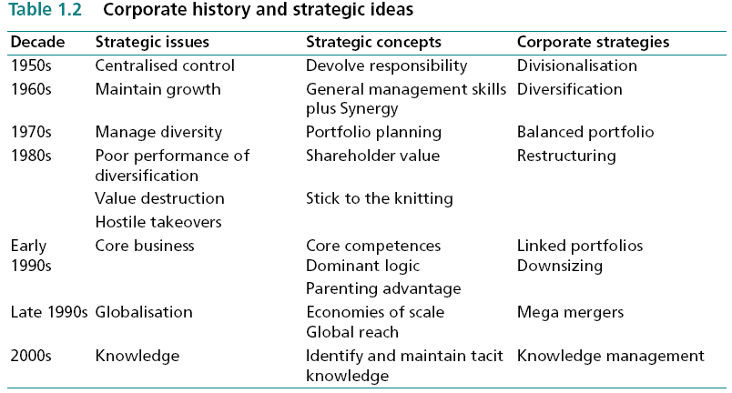
The Development of Strategic Ideas
Development of Corporate Strategies
The pursuit of value creation has led to changes in corporate strategies over time, and how ideas relating to corporate strategy have been greatly influenced by the outcome of previous strategic approaches.

Slide 38
Contents
Strategic Planning: The Context
What Is Strategic Planning?
The Process of Strategy and Decision Making
Business Unit and Corporate Strategy
Is Strategic Planning Only for Top Management?
  Company Benefits of Strategic Planning
  Individual Benefits of Understanding Strategic Planning
  Understanding Strategic Planning: Who Should Pay?

Slide 39
Is Strategic Planning Only for Top Management?
There are potential returns to both the company and the individual from comprehension of strategic planning at all levels of management.
It is not so much the existence of a plan which benefits the company, but the process by which a plan is developed:
  relationships among employees,
  approaches to the job,
  able to interpret corporate objectives,
  where subunits fit into the overall system of objectives,
  understanding of the true opportunity cost of units’ demands in terms of resources, or produce arguments.
  more balanced view of the actions of others and better appreciation,
  elimination of unnecessary conflicts and the associated effects on morale and productivity.

Slide 40
End of Module 1

